Slide 1
CSS Specificity
Mike shoaf
Cit 230

Slide 2
Specificity
Specificity is the means by which browsers decide which CSS property values are the most relevant to an element and, therefore, will be applied.
There are 4 types of specificity that are added up
Inline = a
IDs = b
Classes = c
Types = d
Added by this situation:
a, b, c, d
A = 1000, B=100, C=10, D=1

Slide 3
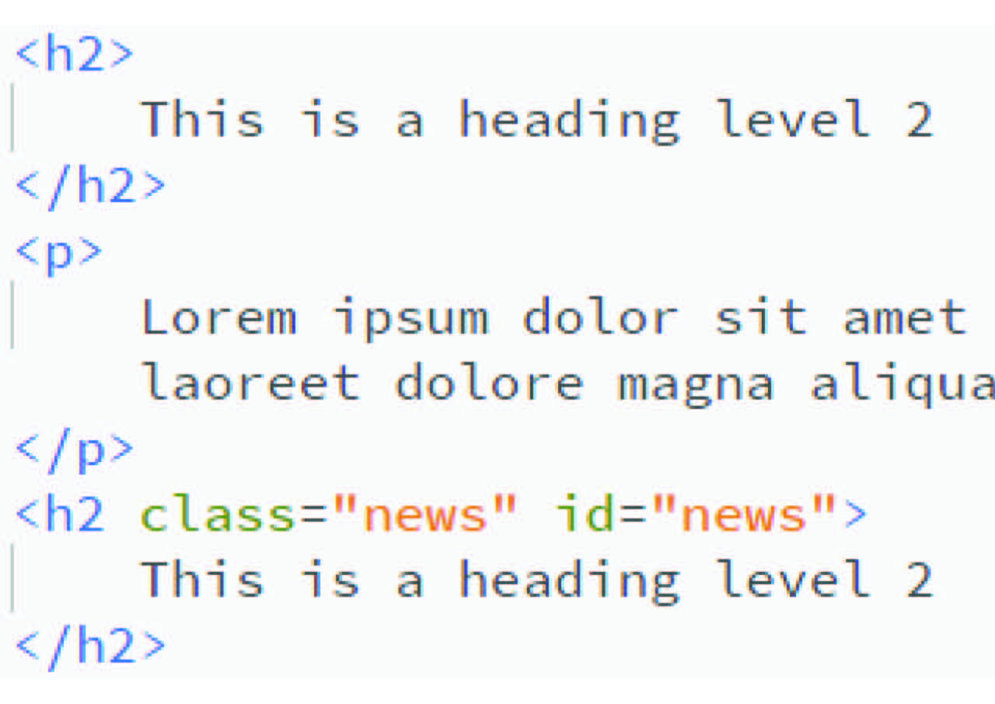
Types
Types are classified as:
Elements
i.e.:
h2, p, etc…
Code in CSS:
h2 { color: green; }
This will change ALL h2 elements

Slide 4
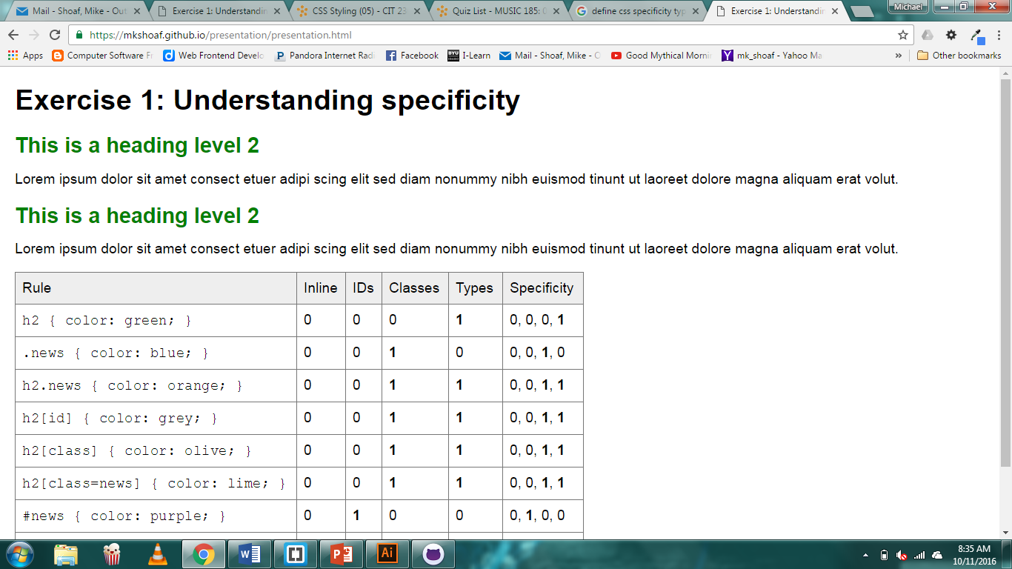
How it looks

Slide 5
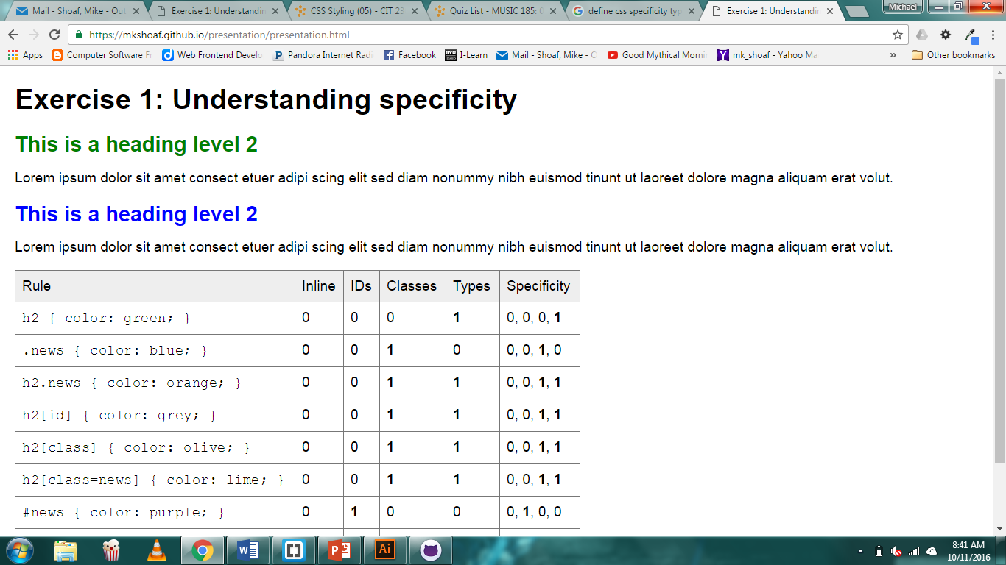
Classes
Will be:
class=“…”
In this example it was coded as:
.news { color: blue; }
It pulls out anything with ‘class=“news” ‘

Slide 6
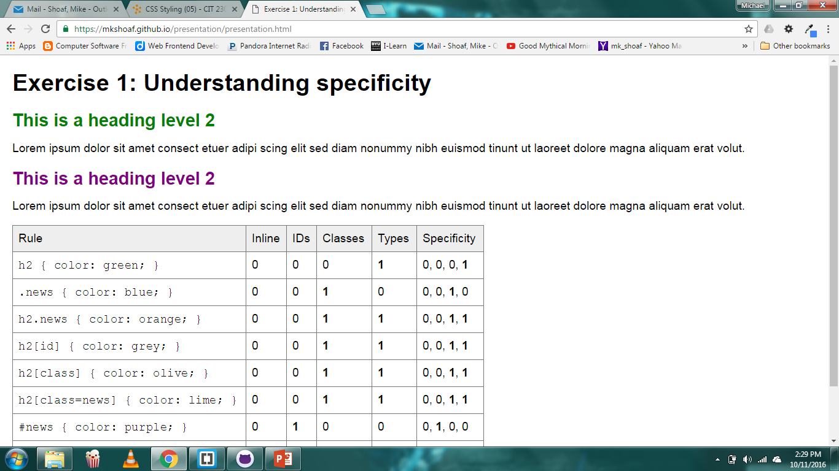
IDs
Will be:
id=“…”
In this example it was coded as:
#news { color: purple; }
It pulls out anything with ‘id=“news” ‘

Slide 7
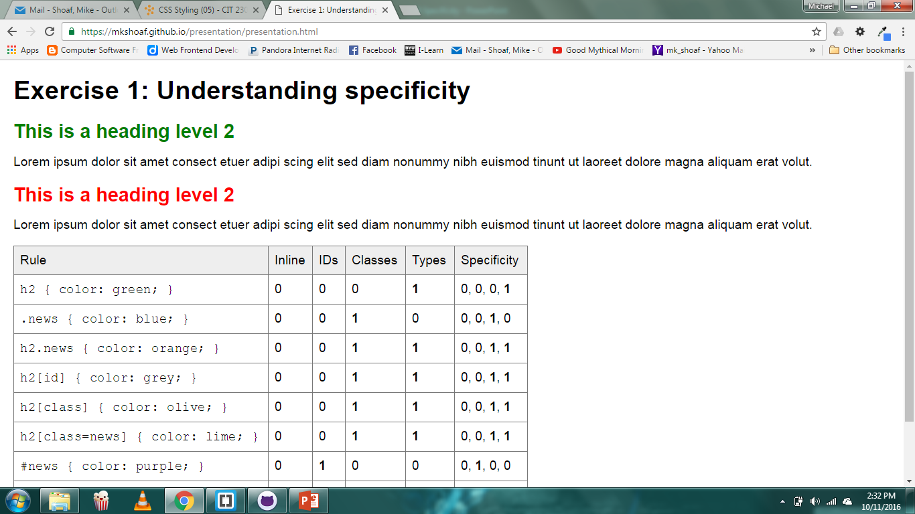
Inline
Will be:
<h2 … style=“color: red; >
This is the most powerful out of the 4 types.

Slide 8
Example
Table of examples
mkshoaf.github.io

Slide 9
Sources
http://www.w3schools.org
http://www.sitepoint.com

